Slide 1



Using AI to Reach Immersive Quality Benchmarks in Extended Reality (XR).
30 sec Playstation VR video
Jason Noble
June 22, 2025
National University
Data Science Program
Playstation, 2023
Notes:
Welcome everyone. I am Jason Noble. Today, I am discussing how Artificial Intelligence is needed to reach the benchmarks to make extended reality feel immersive. (Play)
Two years ago, In July 2023, Virtual Medicine released Human Anatomy VR for Playstation 4 and 5. The trailer promoted it as the pinnacle of immersive human anatomical experiences. So, how do we get from this video game to a photo-realistic, multi-sensory, truly-immersive reality?

Slide 2
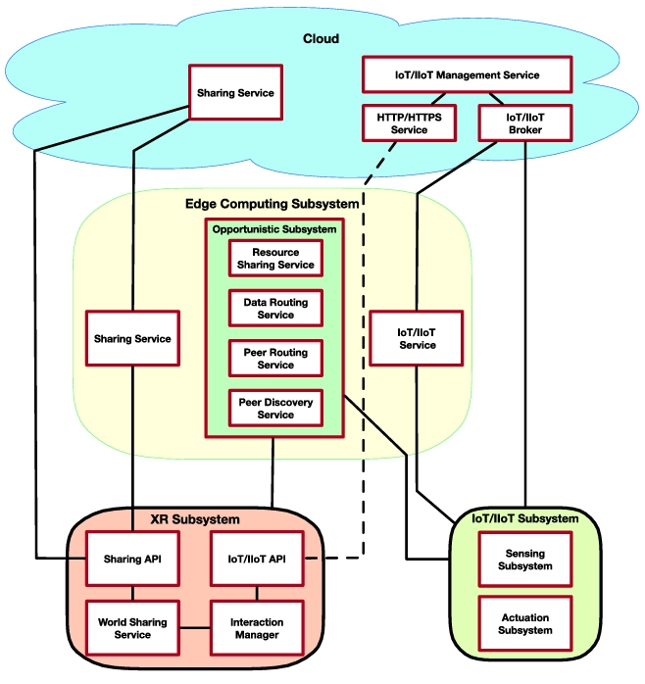
This presentation explores how edge computing and data flow management require AI to support future XR
Edge computing
Data flow
Fernández, 2024
Notes:
(at two levels Network and device)

Slide 3
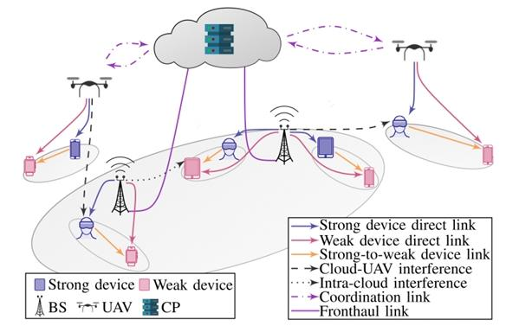
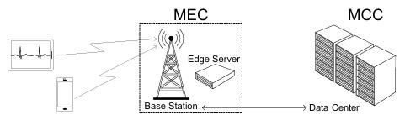

Immersive XR requires high performance and ultra-low latency, pushing computation closer to user via edge
Reifert, 2023
Alekseeva, 2024
LP

Slide 4
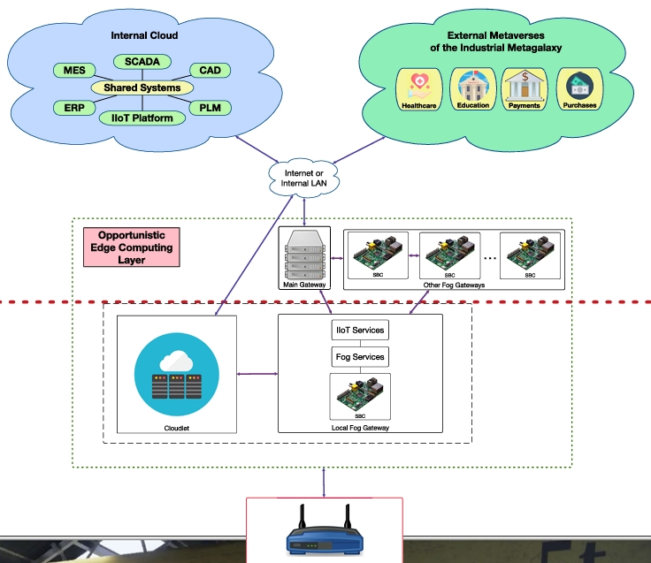
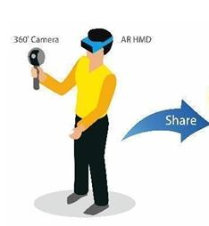
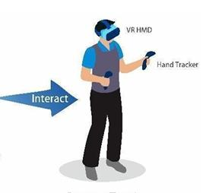
AI dynamically manages data flow and resources at the edge to meet XR’s real-time demands.
LP
Fernández, 2024

Slide 5
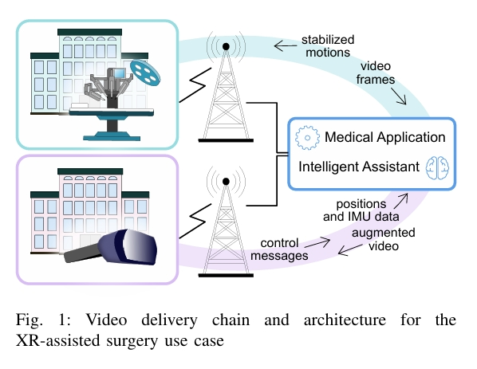
To support XR data requirements, networks must supply stable bandwidth and control latency
ID
Alekseeva, 2024

Slide 6
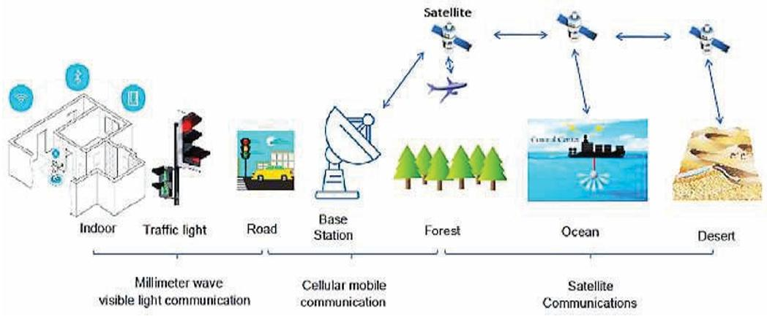
AI algorithms will allow networks to forecast data and location demands, proactively allocating resources
ID
Saxena, 2024

Slide 7
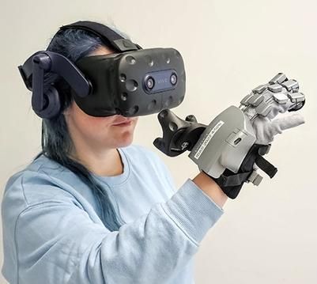
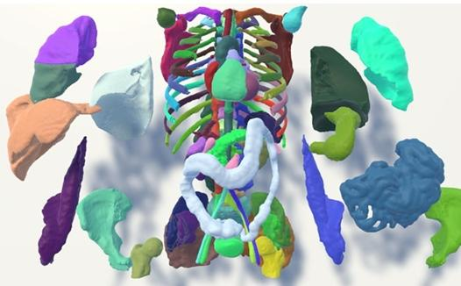

XR devices are constrained by limited processing power, battery life, and complex multi-sensory data fusion
ID
Krieger, 2023

Slide 8

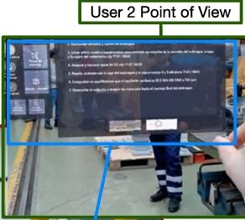
AI enables intelligent task offloading between processing nodes to balance load and reduce latency
ID
Fernández, 2024
Notes:
Nodes -- devices, edge sever, and cloud servers

Slide 9
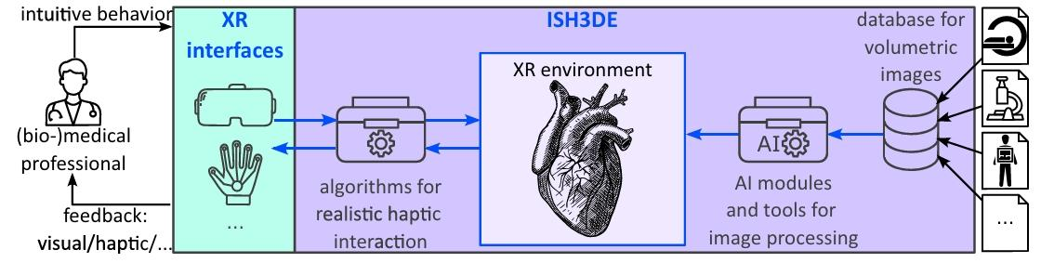
To review; using AI to enhance edge computing and data flow is fundamental to successful XR immersion
Questions?
Edge computing
Data flow
Krieger, 2023

Slide 10

Resources
Alekseeva, D., Ometov, A. (2024). Hybrid Edge-Cloud Computational Offloading for XR Medical Applications. In 9th International Conference on Fog and Mobile Edge Computing (FMEC). IEEE. http://DOI.org/10.1109/FMEC62297.2024.10710197
Fernández-Caramés, T.M., Fraga-Lamas, P. (2024) Forging the Industrial Metaverse for Industry 5.0: Where Extended Reality, IIoT, Opportunistic Edge Computing, and Digital Twins Meet. http://doi.org/10.1109/ACCESS.2024.3422109
Kourtesis, P. A (2024). Comprehensive Review of Multimodal XR Applications, Risks, and Ethical Challenges in the Metaverse. Multimodal Technol. https://doi.org/10.3390/mti8110098
Krieger, K., Egger, J., Kleesiek, J., Gunzer, M., & Chen, J. (2024). Multisensory Extended Reality Applications Offer Benefits for Volumetric Biomedical Image Analysis in Research and Medicine. Journal of Imaging Informatics in Medicine, 38, 646–655. https://doi.org/10.1007/s10278-024-01094-x
Playstation.(2023). Human Anatomy VR - Launch Trailer https://www.youtube.com/watch?v=T-q5i8NFZNI
Reifert, R.J., Dahrouj, H., Sezgin, A. (2023). Extended Reality via Cooperative NOMA in Hybrid Cloud/Mobile-Edge Computing Networks. Internet of Things Journal. IEEE. https://doi.org/10.48550/arXiv.2310.06874
Saxena, A., Kumar, S. C., Kumar, R. V., & Karpagam, J. (2024). Navigating of 6G Network into the Latest AI Technology for the Fastest Communication Without Loosing the Data. In 2024 4th International Conference on Advance Computing and Innovative Technologies in Engineering. IEEE. https://doi.org/10.1109/ICACITE60783.2024.10616812

